Slide 1

Equity Entity
Nikesh Biraggari
Kusumanth Reddy
Revanth padala

Slide 2

Introduction
The stock market is made up of a network of exchanges. Each exchange serves as a specific platform for the trading of stocks listed on it, allowing the meeting of buyers and sellers. Furthermore, the exchange methodically records each stock's supply, demand, and pricing, establishing a clear link between these crucial market parameters.

Slide 3

Problem statement
Our goal is to create an effective digital application designed for stock exchange operations, giving a reliable system for specialists to buy, sell, or examine stocks and commodities. Administrative professionals will also be able to use the site, with the ability to add or remove company stock listings as needed.

Slide 4

Solution Offered
Enables users to engage in trading activities encompassing both commodities and stocks.
Businessmen have the ability to establish a new company, obtain a business license, and then list their firm on the stock exchange.
New brokers may register, get allocated a market, and aid investors in completing deals. Brokers can work in the equities and commodity markets.
Using this app, each investor can keep tabs on their holdings as well as their gains and losses. At the end of the day, a market analyst produces a report for both the market and specific stocks.

Slide 5
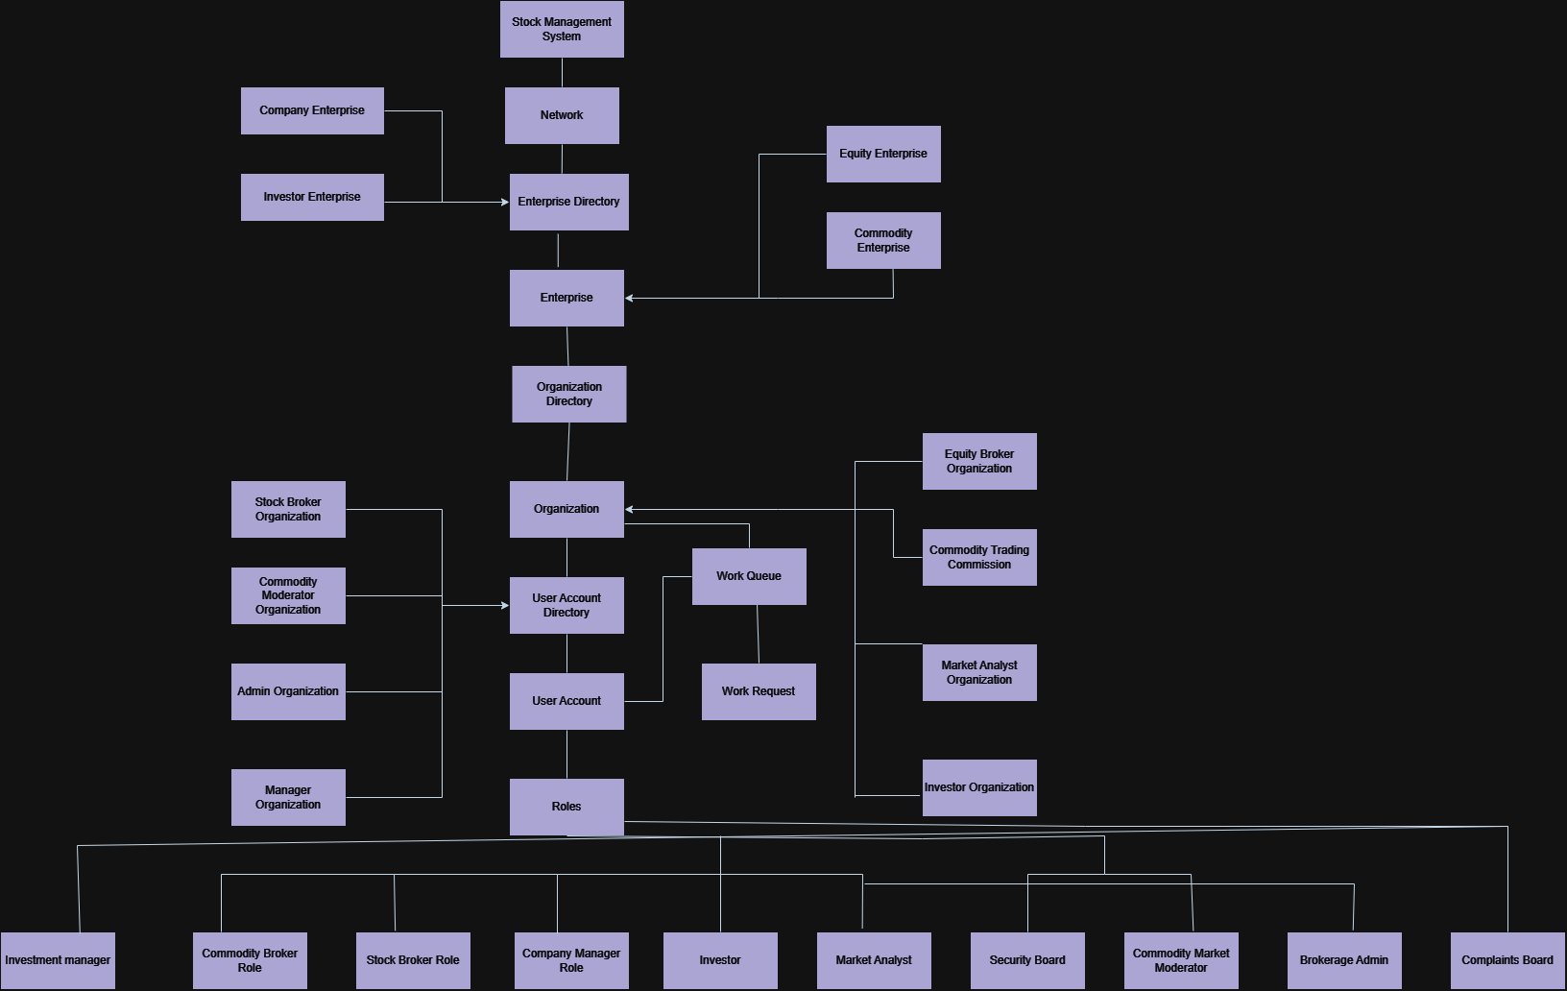
Sequence Diagram

Slide 6
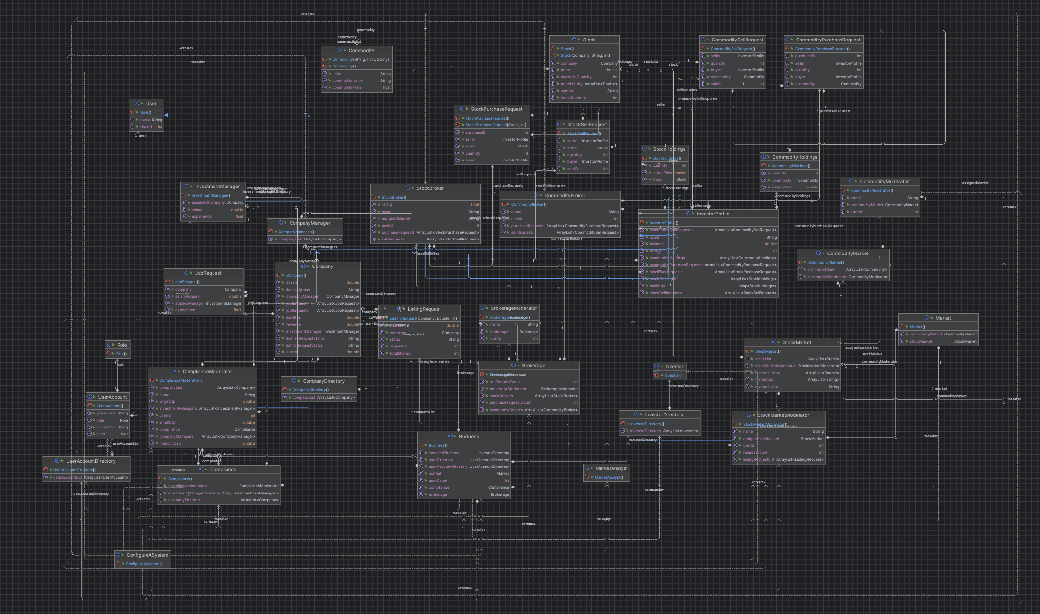
Class Diagram

Slide 7

Enterprises & Organizations
1. Investor
- Investor Organization – Investor, Investment Manager
2. Stock Market
- Stock Broker Org, Security Board, Broker’s Commission Admin
3. Commodity Market
- Commodity Broker, Commodity Trading Commission
4. Company
- Company Manager, Compliance Board
5. Market Analyst
- Market Analyst

Slide 8
Roles
Investor: View and sell equities/commodities, add balance to their account.
Stock Broker/ Commodity Broker: They approve or reject the request of buying or selling of equity/commodity.
Market Analyst: Views market trends in graphs.
Broker admin: Can assign a broker to the market.
Commodity market Moderator: Can add new commodities, modify rate of commodity.
Company Manager: Add new stocks of company.
Security Board: Approve or reject the listing of the company, can see all the investment managers.
Investment manager: Can buy his own company stocks which can be approved or declined by respective equity broker.
Compliance Board: Will Approve licence of the comapany

Slide 9
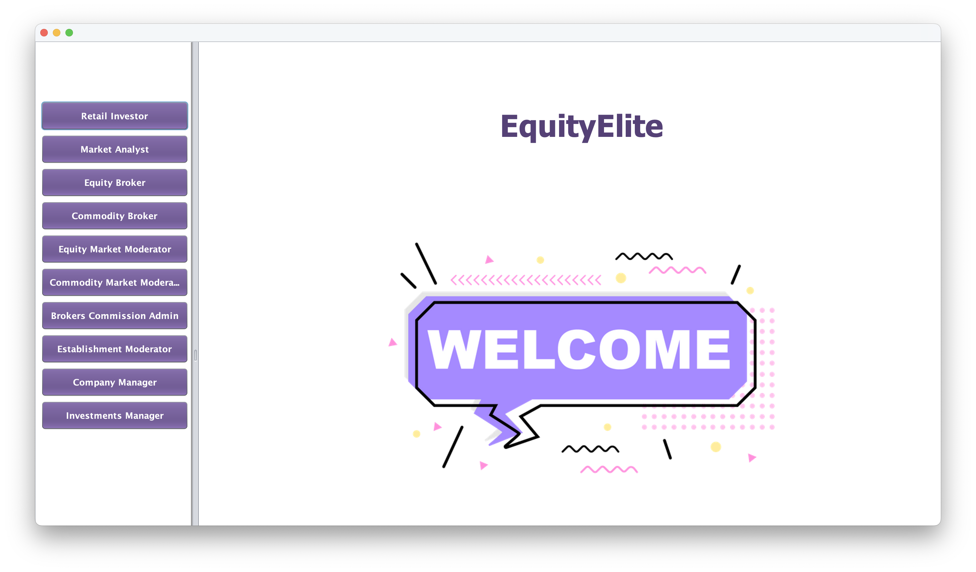
User Interface & Design

Slide 10
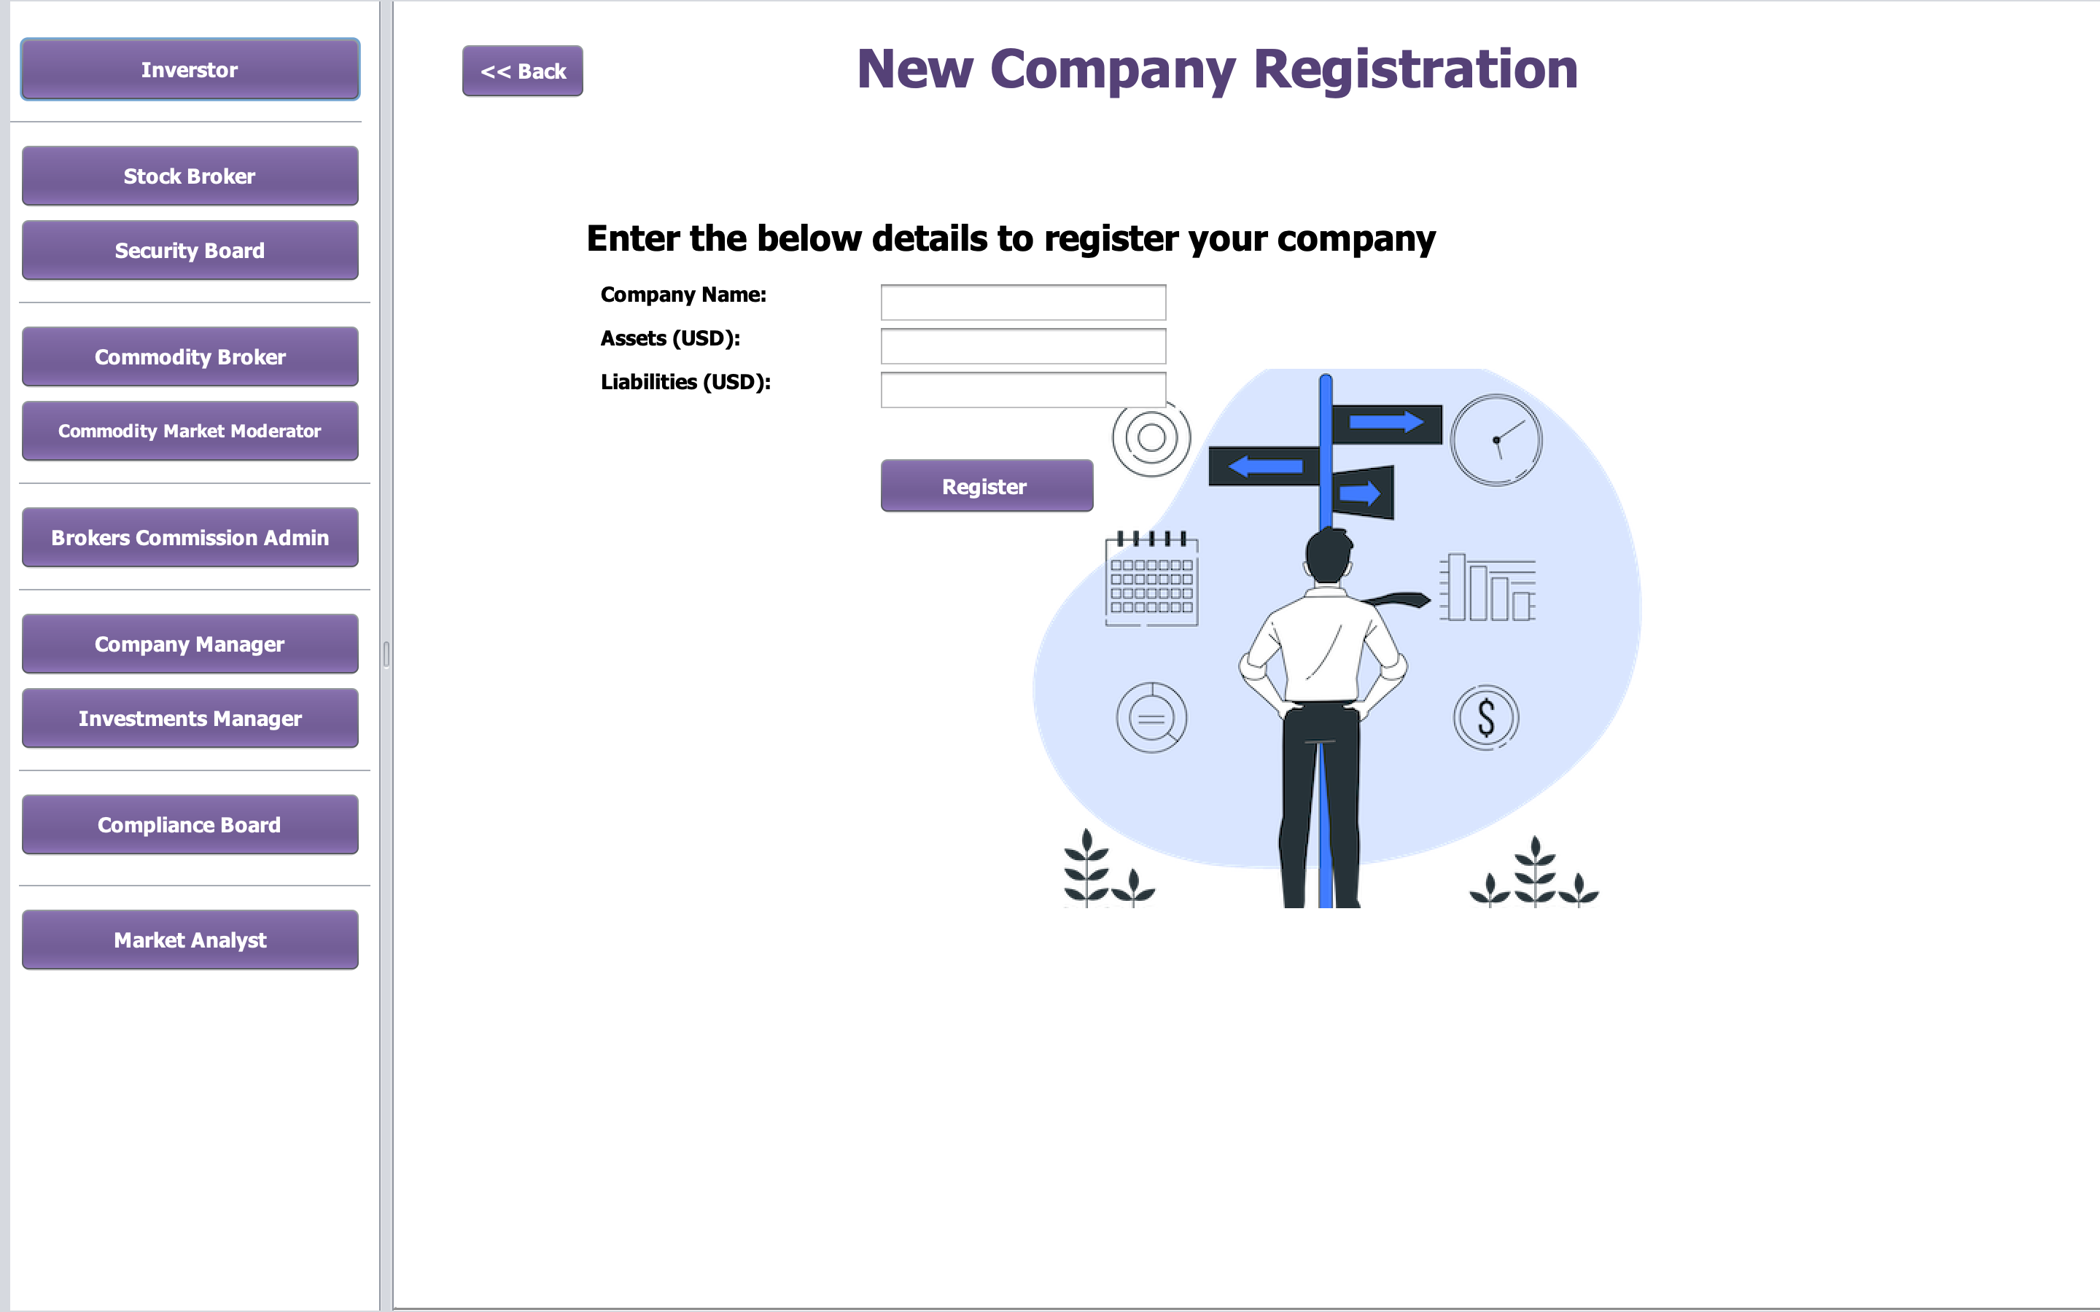

Slide 11
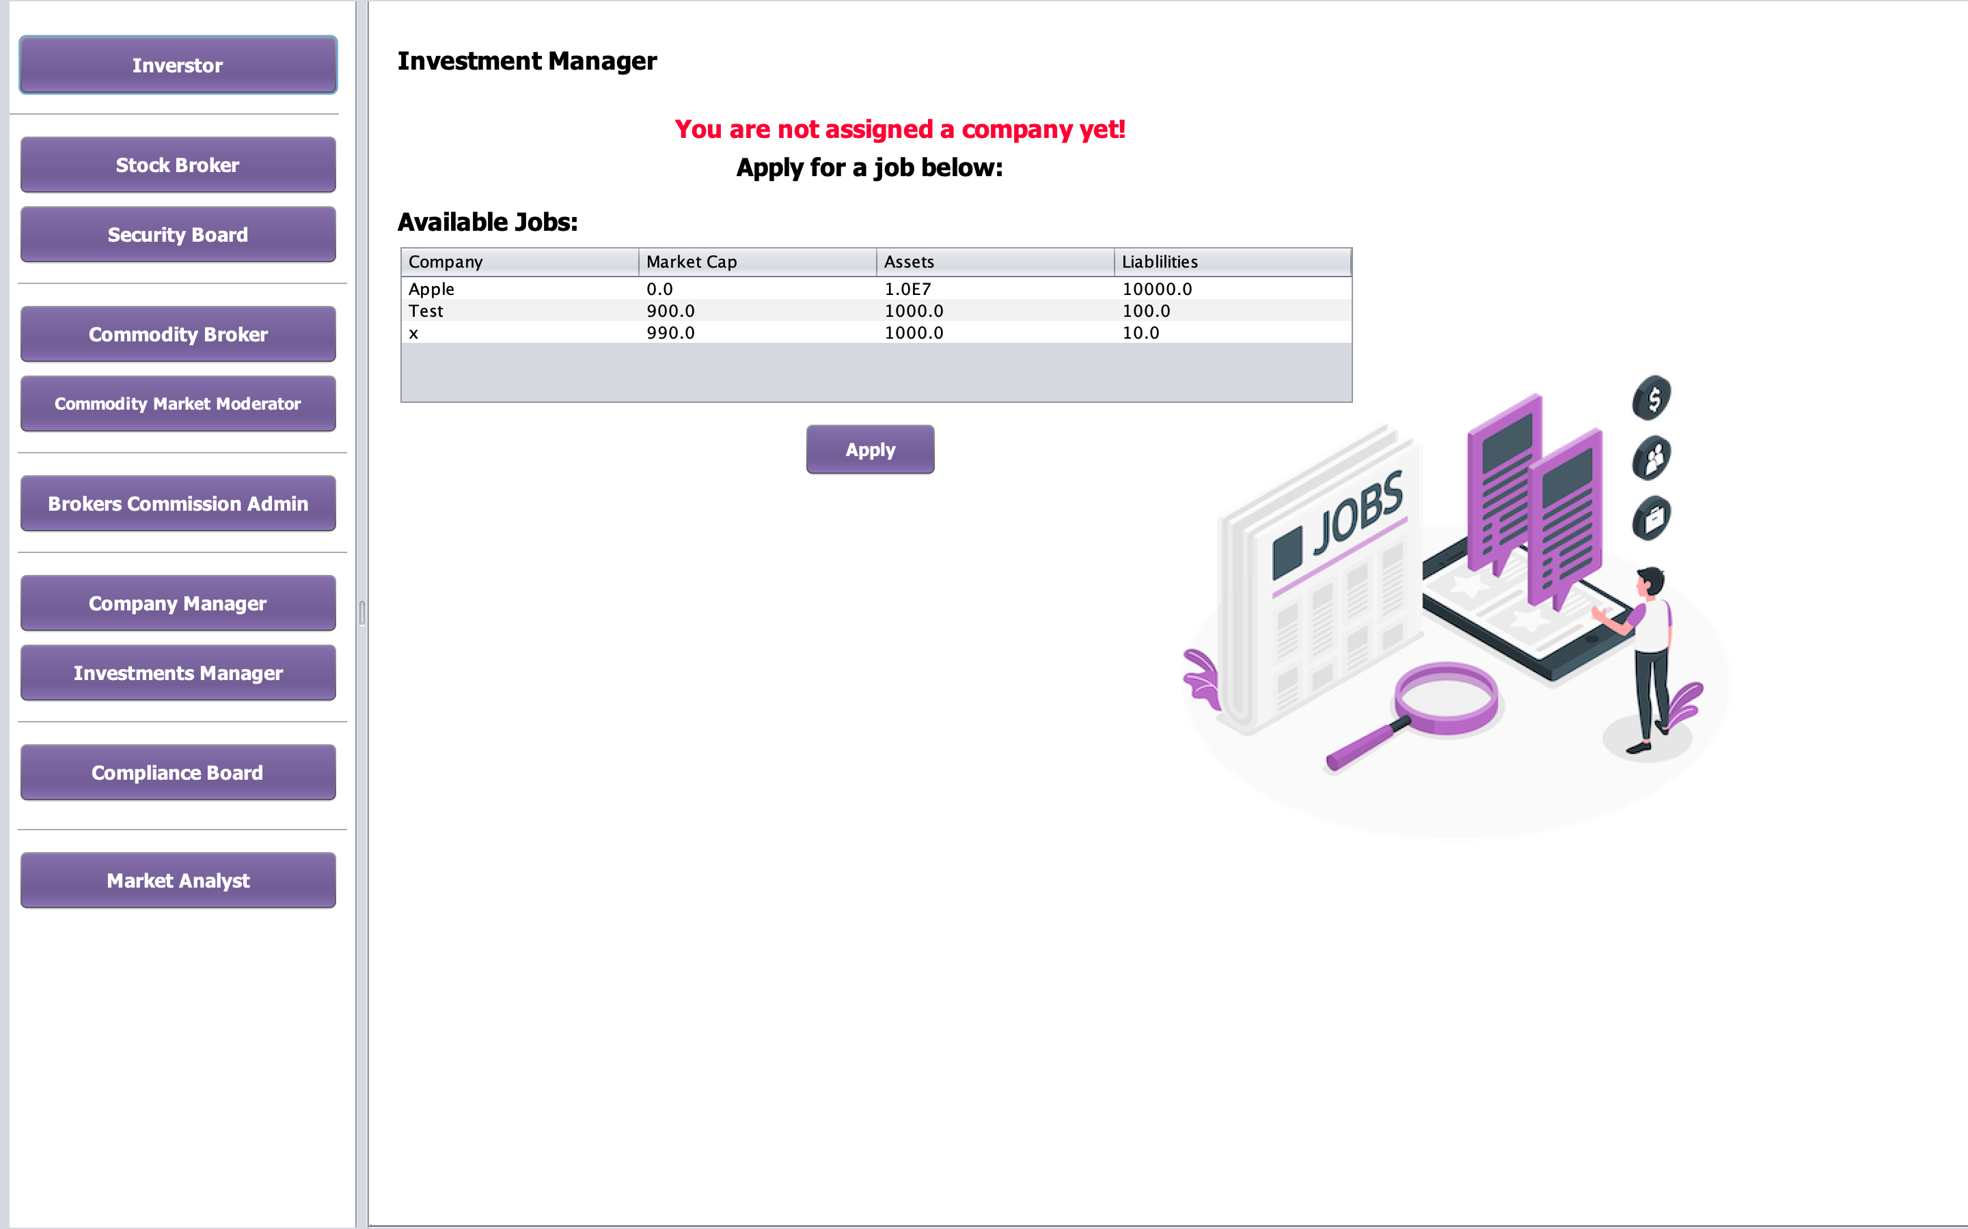

Slide 12
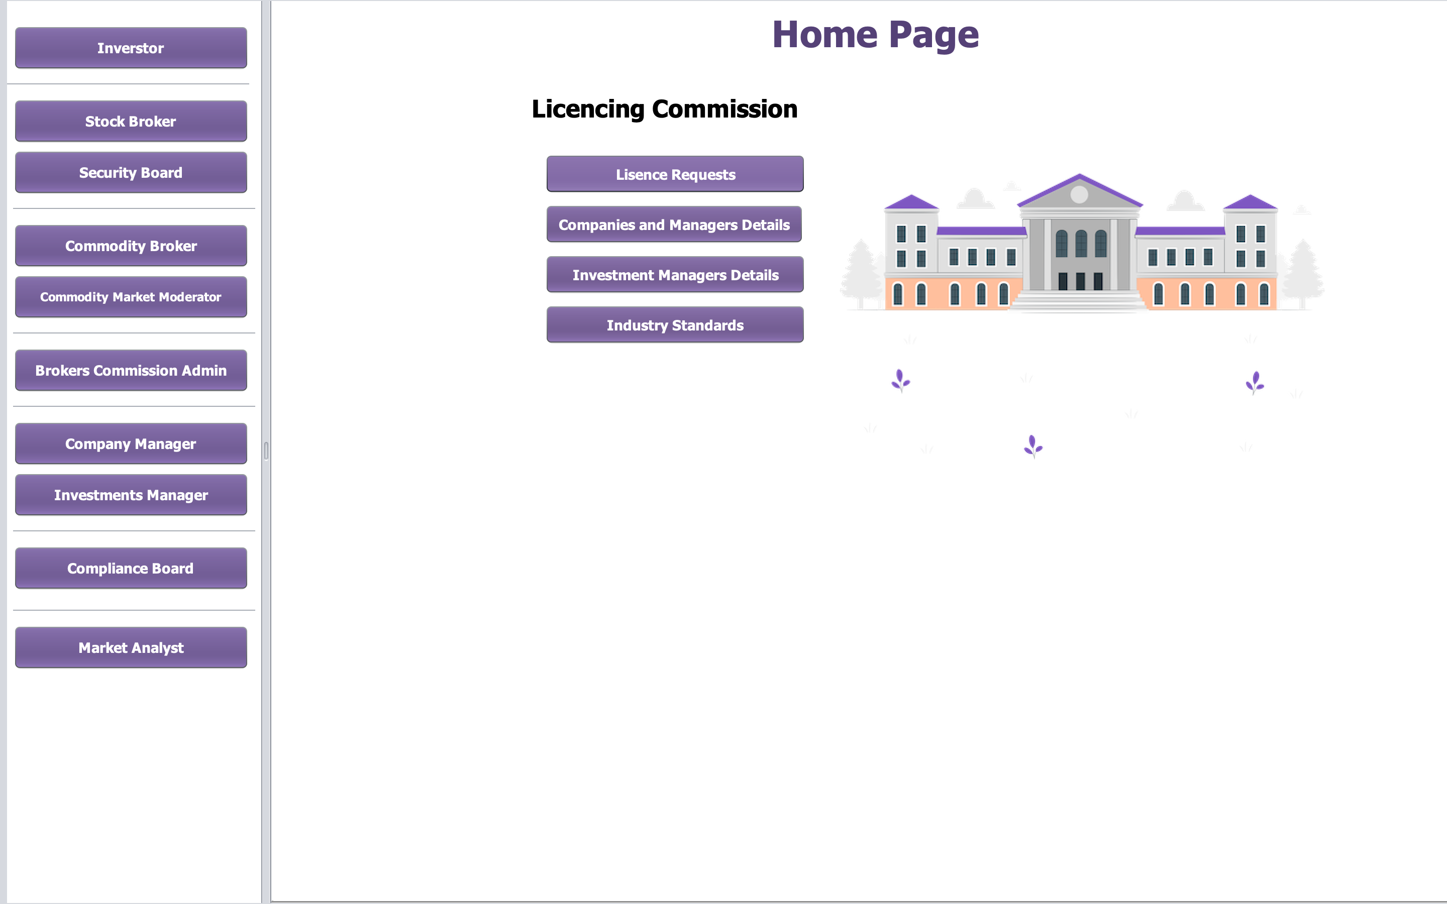

Slide 13
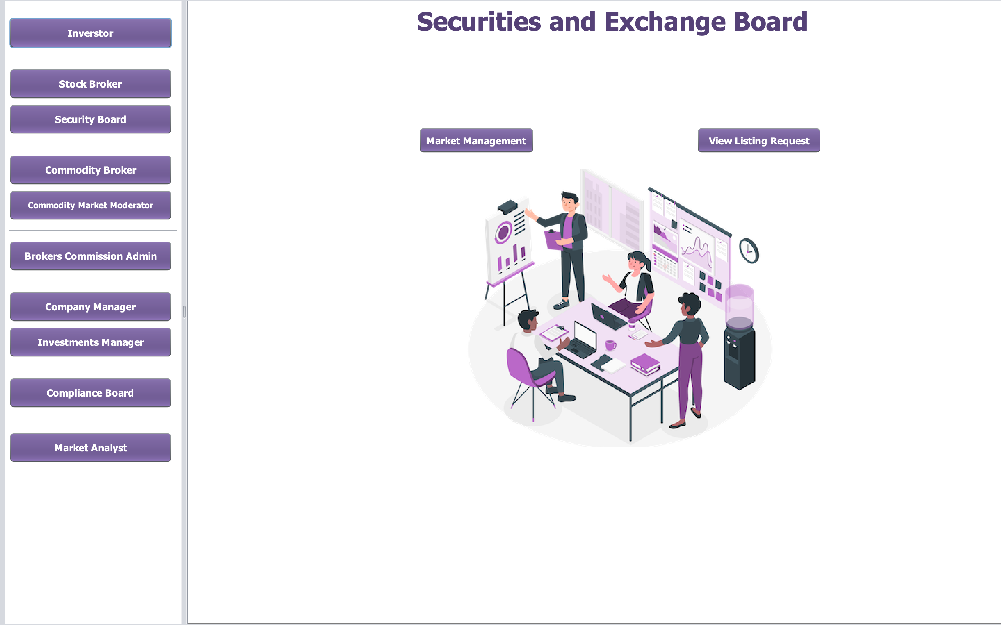

Slide 14
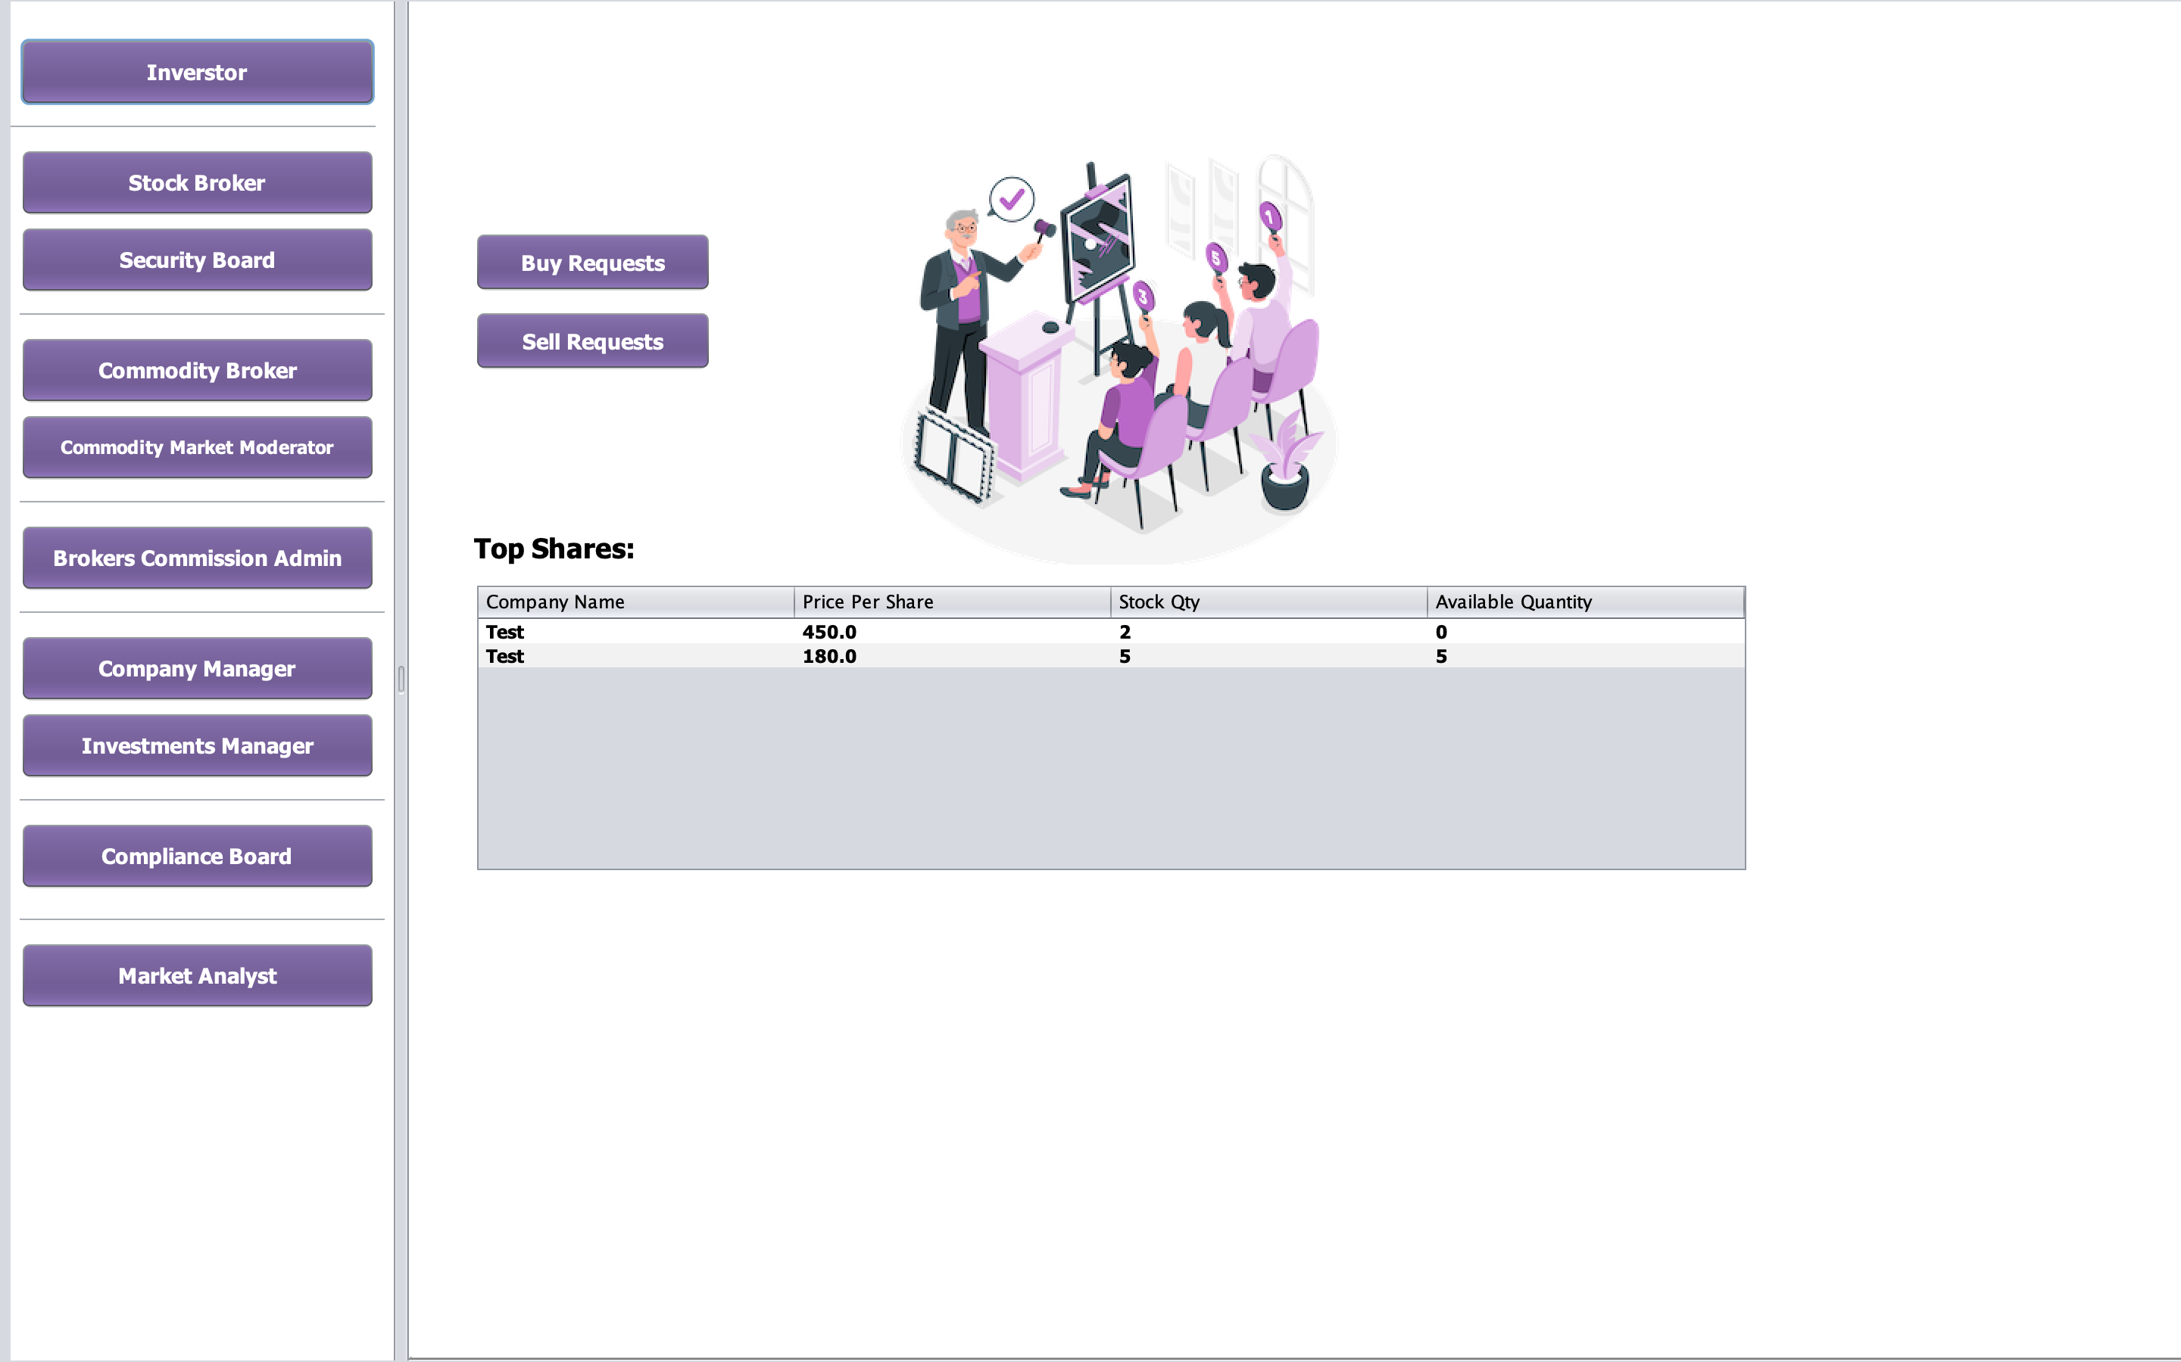

Slide 15
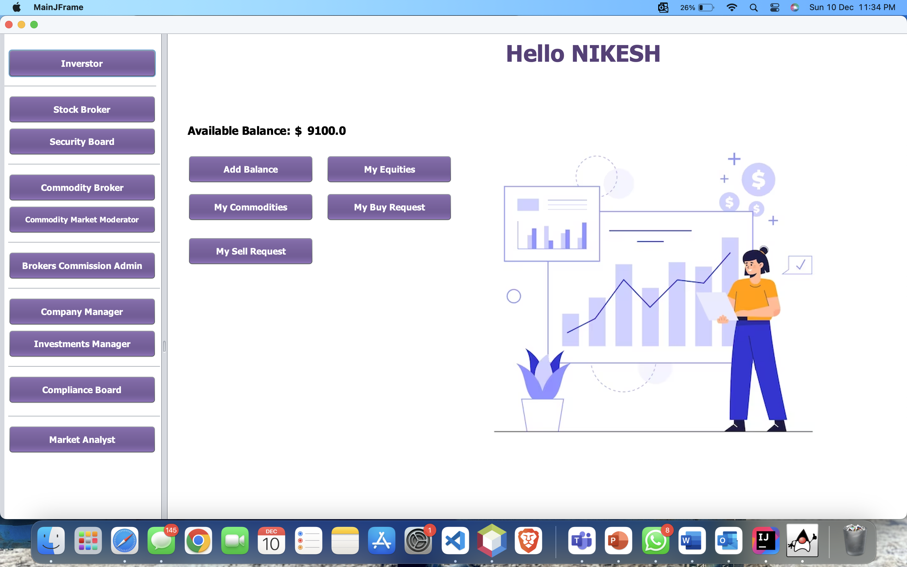

Slide 16
References
Investopedia: https://www.investopedia.com/terms/s/stockmarket.asp
Commodity-traders: https://www.ziprecruiter.com/t/Most-Popular-Types-Of-Commodity-Trader-Jobs
Images: https://storyset.com/
Wikipedia: https://en.wikipedia.org/wiki/Stock_exchange

Slide 17

Thank you

